Slide 1
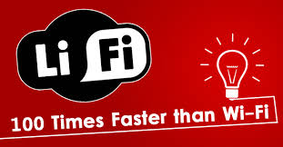
Mobile & Wireless Technology CT090-3-2 & Version 2
The Future Li-Fi

Slide 2
Topic & Structure of The Lesson
Light fidelity (Li-Fi): towards all-optical networking
Li-Fi internet (2015): First real-world usage boasts speed 100 times faster than Wi-Fi

Slide 3
Learning Outcomes
At the end of this topic, You should be able to
Be familiar with Li-Fi and its working principle
Compare Li-Fi with Wi-Fi

Slide 4
Key Terms You Must Be Able To Use
If you have mastered this topic, you should be able to use the following terms correctly in your assignments and exams:
Li-Fi
VLC
LED
Exabyte

Slide 5
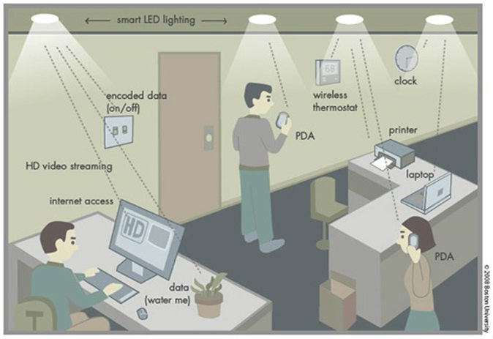
Li-Fi – Light Fidelity

Slide 6
Li-Fi
So, first things first – what exactly is Li-Fi?
The term was first coined by German physicist Harald Haas at a TED talk back in 2011, where he discussed the idea of using light bulbs as routers.
He took this idea and, together with a group from the University of Edinburgh, founded pure LiFi a year later.
The idea behind Li-Fi is to use a form of visible light communication (VLC – not to be confused with the popular media player) instead of radio waves like conventional Wi-Fi routers, enabling much faster data transfer speeds.

Slide 7
Li-Fi
VLC technology delivers high-speed, bi-directional mobile communications similar to Wi-Fi, but in a much more secure way.
In fact, Li-Fi technology is able to increase bandwidth by 100 times and recently managed to achieve 1Gbps real-world results during testing, while boasting a theoretical top speed of 224Gbps.
This means that you’d be able to download 18 1.5GB movies in a single second. We’ll let that sink in.
The technology isn’t affected by the number of devices using the signal either, a massive bonus when compared to traditional Wi-Fi technology.

Slide 8
Li-Fi – How does Li-Fi work?
While that all sounds well and good, how does Li-Fi actually work? Standard LED light bulbs use a constant current, which emits a constant stream of photons perceived by us as visible light.
Li-Fi is different because the current it uses varies, meaning that the output intensity of the light fluctuates.

Slide 9
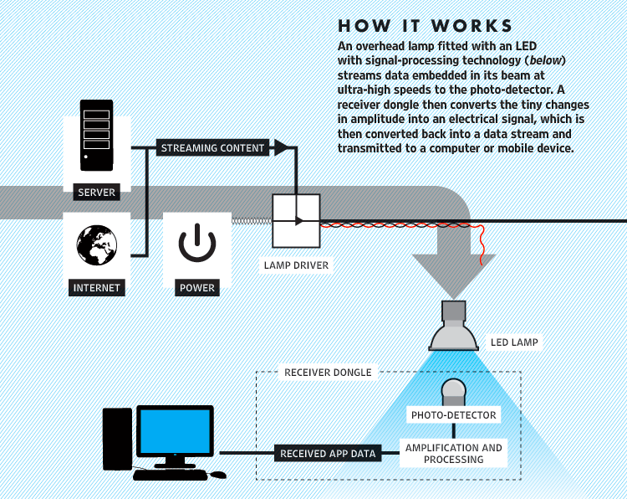
Li-Fi – How does Li-Fi work?

Slide 10
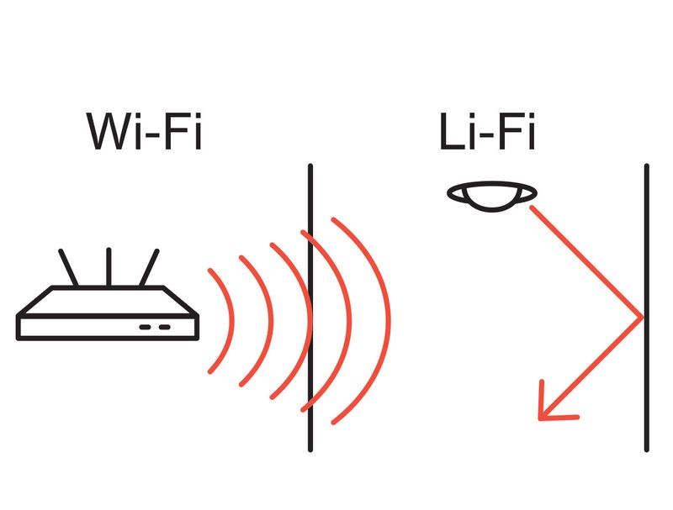
Li-Fi – Benefits & Limitations
Aside from its superior speed, Li-Fi also boasts a number of other benefits over Wi-Fi. For instance, the fact that the signal is carried by optical light means that it cannot travel through walls, therefore enhancing the security of local networks.
Obviously, this produces a number of limitations as well, since it suggests that connection will be lost if a user leaves the room, representing a major hurdle that must be overcome if the technology is to be successfully implemented.

Slide 11
Li-Fi – Benefits & Limitations
However, if this barrier can be surmounted, then the use of the visible spectrum could allow Li-Fi to send messages across a much wider range of frequencies than Wi-Fi, which operates between the frequencies of 2.4 gigahertz and 5 gigahertz.
As such, it has been suggested that Li-Fi could provide the answer to increasing frequency congestion as Internet usage continues to rise across the world.

Slide 12
Li-Fi – Benefits & Limitations
According to the Cisco Visual Networking Index Global Mobile Data Traffic Forecast, global monthly data usage is expected to exceed 24.3 exabytes by 2019 – a volume which current wireless connections are not able to handle.
In a recent TED talk, Haas insisted that household LED light bulbs could easily be converted into Li-Fi transmitters, providing Internet users with more efficient connections.

Slide 13
Li-Fi
“All we need to do is fit a small microchip to every potential illumination device and this would then combine two basic functionalities: illumination and wireless data transmission,” he said.
It is also worth mentioning that the speed at which these LEDs flicker in order to relay data is too fast for the human eye to perceive, so users will not have to worry about annoying flashes in their ambient light.

Slide 14
Li-Fi Vs Wi-Fi
While some may think that Li-Fi with its 224 gigabits per second leaves Wi-Fi in the
dust, Li-Fi's exclusive use of visible light could halt a mass uptake.
Li-Fi signals cannot pass through walls, so in order to enjoy full connectivity,
capable LED bulbs will need to be placed throughout the home.
Not to mention, Li-Fi requires the light bulb is on at all times to provide
connectivity, meaning that the lights will need to be on during the day.
Additionally, where there is a lack of light bulbs, there is a lack of Li-Fi internet so
Li-Fi does take a hit when it comes to public Wi-Fi networks.
An extension of standard Wi-Fi is coming and it's called Wi-Fi HaLow.

Slide 15
Quick Review Question
What is LiFi? How does LiFi work?
Compare LiFi with WiFi.

Slide 16
Summary of Main Teaching Points
Discussed Li-Fi and its working principle
Compared Li-Fi with Wi-Fi

Slide 17
Question and Answer Session
Q & A

Slide 18
What we will cover next
Assessment Discussion
Presentation

